Slide 1
Be Triumphant
Revelation
Dr. Rick Griffith • Crossroads International Church Singapore
BibleStudyDownloads.org

Slide 2
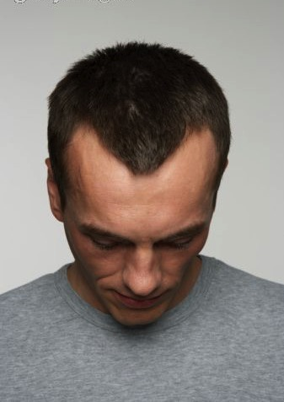
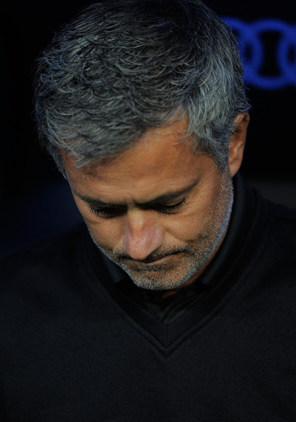
What causes you
Transition?
Finances?
Physical?
Relational?
… to look down?

Slide 3
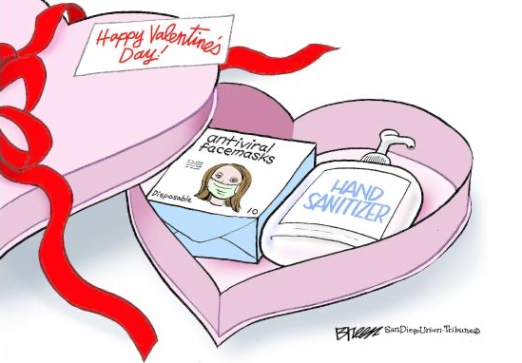
Coronavirus 2020
Notes:
The present Coronavirus
• has even changed the Valentine Day gifts this year from chocolates to antiviral facemasks and hand sanitizer.
• More seriously, Pastor Wilson Teo of Grace Assembly has contracted it along with 6 other members—even worse is the thought that China is concealing the deaths of millions instead of thousands.
These are such perilous times with the coronavirus that we don’t even know if it will be legal to meet next Sunday.

Slide 4
How can you look up to the LORD during your struggle?

Slide 5
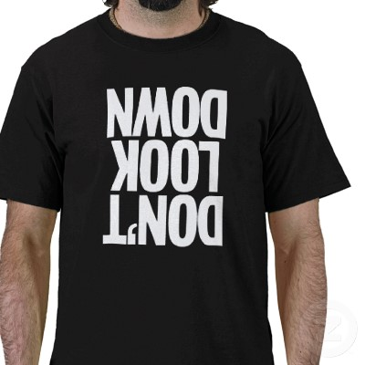
Don't Look Down
DON'T LOOK DOWN
Notes:
We are tempted to look down when things don't go our way

Slide 6
How can we be triumphant in Christ?
What do we need to grasp about Jesus for victory?

Slide 7
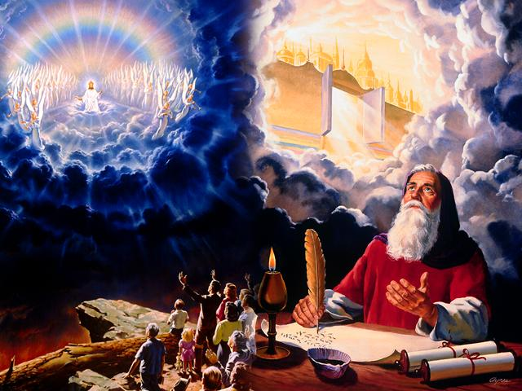
Revelation
Dr. Rick Griffith • Singapore Bible College • BibleStudyDownloads.org

Slide 8
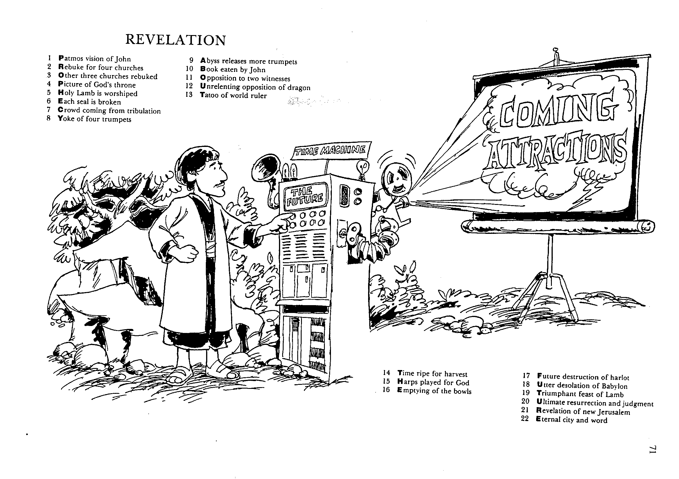
REVELATION
1 Patmos vision of John
2 Rebuke for four churches
3 Other three churches rebuked
4 Picture of God's throne
5 Holy Lamb is worshipped
6 Each seal is broken
7 Crowd coming from tribulation
8 Yoke of four trumpets
9 Abyss releases more trumpets
10 Book eaten by John
11 Opposition to two witnesses
12 Unrelenting opposition of dragon
13 Tattoo of world leader
14 Time ripe for harvest
15 Harps played for God
16 Emptying of the bowls
17 Future destruction of harlot
18 Utter desolation of Bablyon
19 Triumphant feast of Lamb
20 Ultimate resurrection and judgment
21 Revelation of new Jerusalem
22 Eternal city and word
Barry Huddleston, The Acrostic Bible

Slide 9
Christ's sovereignty over future events transmitted to John shows the prophecy as inspired (1:1-2)
322
Points H & I
God
"The revelation of Jesus Christ, which God gave him to show to his servants the things that must soon take place. He made it known by sending his angel to his servant John, who testifies to everything he saw––that is, the word of God and the testimony of Jesus Christ" (1:1-2 NIV).
Jesus
Angel
John
Readers (servants)
Notes:
"How did the Lord convey the contents of this book to His servant? According to Revelation 1:1–2, the Father gave the revelation to the Son, and the Son shared it with the apostle, using "His angel" as intermediary. Sometimes Christ Himself conveyed information to John (Rev. 1:10ff); sometimes it was an elder (Rev. 7:13); and often it was an angel (Rev. 17:1; 19:9–10). Sometimes a "voice from heaven" told John what to say and do (Rev. 10:4). The book came from God to John, no matter what the various means of communication were; and it was all inspired by the Spirit" (Wiersbe, Be Ready, Bible Exposition Commentary).

Slide 10
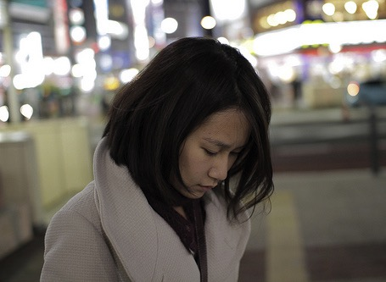
Revelation tells us to look up to…

Slide 11
The Sovereignty of Jesus Christ

Slide 12
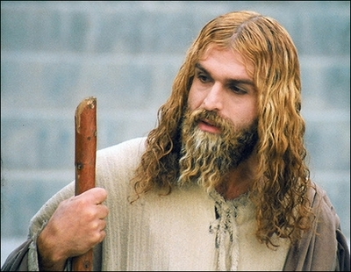
A Muslim actor as Jesus Christ in Iran (29 April 2008)
Who am I?
Notes:
http://latimesblogs.latimes.com/babylonbeyond/2008/04/iran-an-iranian.html
IRAN: A Muslim actor as Jesus Christ
Comments (19)
(13)
(0)
April 29, 2008 | 3:00 am
He is an Iranian Muslim who looks so much like a Hollywood or Renaissance image of Jesus Christ that the faithful sometimes make the sign of the cross when they see him.
Ahmad Soleimani-Nia has been playing Jesus for seven years, keeping his hair long and lightly dyed, his beard knotty and vibrant.
He is the star of "Jesus, the Spirit of God," a new film from Iran that depicts the man Christians believe to be the messiah and son of God as a tormented Judean prophet heralding the coming of Muhammad, the founder of the Muslim faith. Nia's Jesus is at once serene, devout, driven and passionate.
In real life, if there is a real life after a spiritual and artistic odyssey that is still not over, Nia lives in Tehran. He was once a soldier in the Iranian army and then a welder for — the irony is interesting in this Jesus story — his nation's Atomic Energy Agency, which the Bush administration accuses of pursuing nuclear weapons.
That may unsettle some American neo-cons, but perhaps not as much as the film itself, which suggests that Jesus wasn't crucified and never rose from the dead.
Check out the rest of the story in today's Los Angeles Times.
— Jeffrey Fleishman in Tehran
Photo: Ahmad Soleimani-Nia as Jesus. Credit: minbar.tatar.ru/rus/Messiah.htm

Slide 13
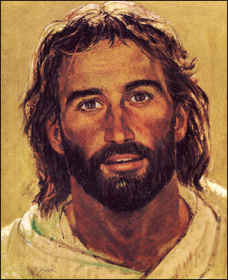
Jesus was relevant in the 1970s

Slide 14
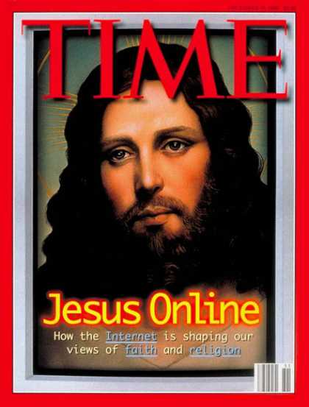
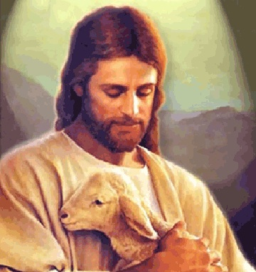
But Jesus became wimpy
Notes:
But then Jesus became wimpy—holding lambs, kissing babies, becoming more effeminate…

Slide 15
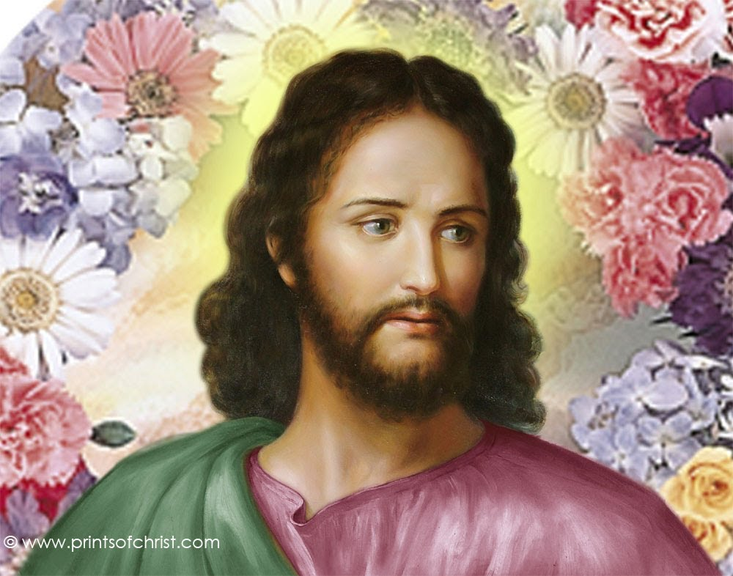
What's the big deal about Jesus?
Notes:
…and basically a flower sniffing Jesus

Slide 16
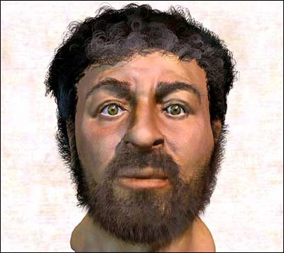
Here Jesus became a caveman
Notes:
This depiction of Christ was determined by collecting samples of first-century Jewish facial bone structures to provide a composite "average" man for that time.

Slide 17
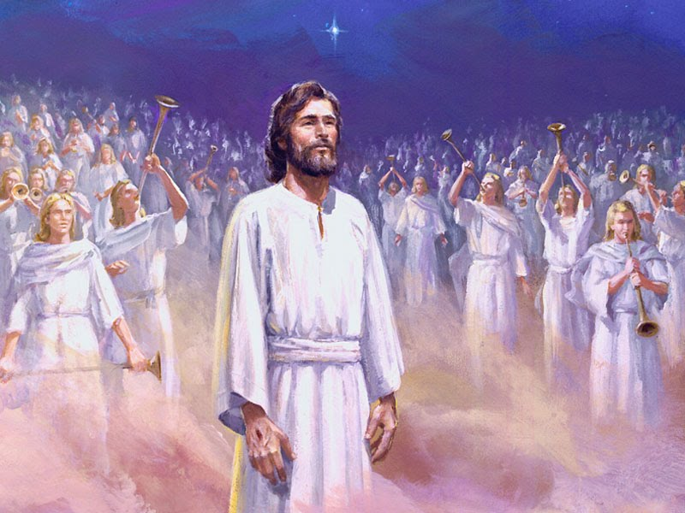
Jesus is the Real King!
318
The Triumph of Christ

Slide 18
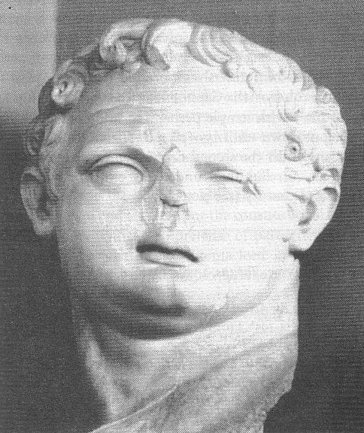
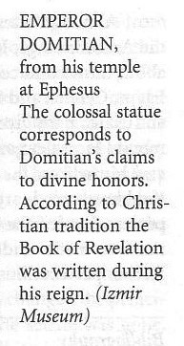
Domitian (AD 81-96)
This bust of Domitian was found in his huge temple at Ephesus—consistent with his claim to divine honors
Book of Revelation (AD 95)

Slide 19
NT Overview (Chronological)
38 124 39-41
"To the remotest part of the earth" (Acts 1:8)
Acts 9 13 14 15 16 18 21 27 28
Apr 48- Sep 49
1 Galatia
Apr 50- Sep 52
2 Aegean
Spr 53- May 57
3 Asia
Feb 60- Mar 62
1 Rome
Spr 62- Fall 67
4 Spain
Aut 67- Spr 68
2 Rome
Summer 35- 37
Damascus Antioch
May 57- Aug 59
Trials
Fall 49
The
Council
Spring 68
Expansion of Church
35 48 49 50 52 53 57 60 62 67 68 95
Matt
Luke
Acts
Mark
John
Gal
1 Thess
1 Cor
Eph
1 Tim
2 Tim
Jude
James
2 Thess
2 Cor
Col
Titus
Heb
1 John
Romans
Philem
1 Pet
2 John
Gospels & Acts
Phil
2 Pet
3 John
Pauline Epistles
1234
Journeys
Rev
General Epistles
Rome
Imprisonments
Chronological

Slide 20
What did John see around him?
Title Page 321
Asian Churches
Rome
2. External Persecution from Rome (1:9; 2:9-10; 3:10)
1. Internal Struggles inside churches (2:4, 14-15, 21-24; 3:1, 15-17)

Slide 21
Theme
23
Sovereignty of Christ in Future Victory
Revelation

Slide 22
We have victory when we see that Jesus rules over…
3 Truths to Grasp in Revelation

Slide 23
Revelation
Sovereignty of Christ in Future Victory
Sovereignty in His Person |  |  | Sovereignty over Churches | Sovereignty in End-Time Events
Chapter 1 |  |  | Chapters 2–3 | Chapters 4–22
"What you have seen" (1:19a) |  |  | "What is now" (1:19b) | "What will take place later" (1:19c)
Past |  |  | Present | Future
Christ Unveiled |  |  | Churches Unveiled | Consummation Unveiled
God on Earth |  |  | God's Ambassadors on Earth | Hell on Earth to Heaven on Earth
The Judge |  |  | The Assignments | The Judgments & Rewards
Subject 1:1-3 | Worship of Trinity 1:4-8 | Glorified Christ 1:9-20 | Seven Churches of Asia: Ephesus Smyrna Pergamum Thyatira Sardis Philadelphia Laodicea | Tribulation 4:1–19:10 | Second Coming 19:11-21 | Millennium 20 | Eternal State 21:1–22:5 | Closing: Imminency 22:6-21
AD 95
318, 324 M

Slide 24
Revelation 1

Slide 25
We have victory when we see that Jesus rules over…
DEATH
(1)
Outline of Revelation
Notes:
Death (1): Christ is sovereign over our ultimate enemy that no one else has defeated.

Slide 26
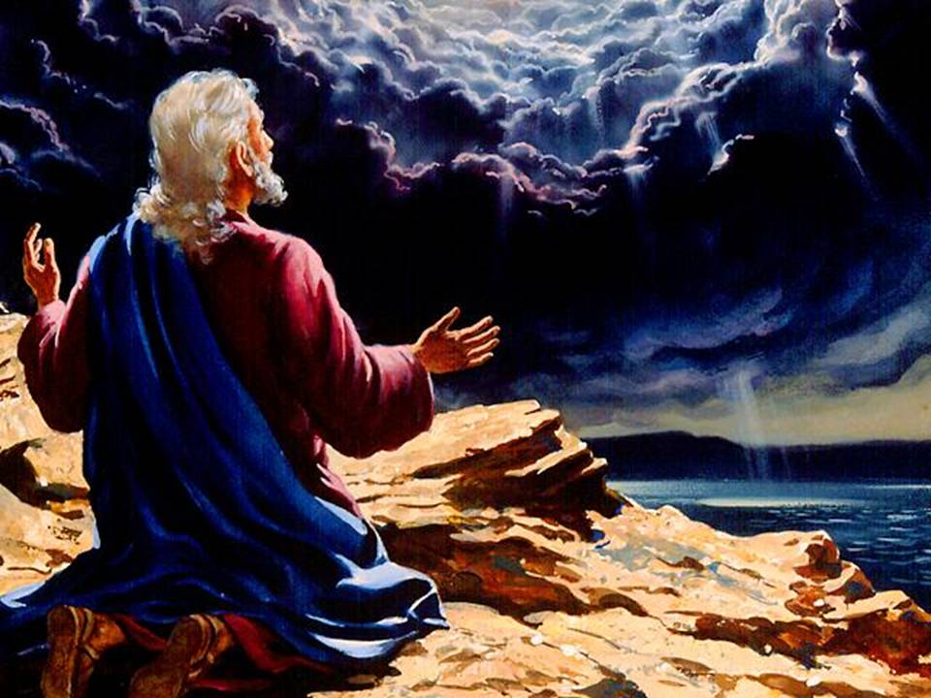
John at Patmos (Rev 1:9-10)
343
Notes:
"Tradition says that it was Domitian who sent John to the Isle of Patmos, a Roman penal colony off the coast of Asia Minor. This being the location of John's exile, perhaps it is not surprising that the word sea is found twenty-six times in his book" (Warren Wiersbe, Bible Exposition Commentary)

Slide 27
The Twofold Context of the Book
Internal Compromise
321
External Persecution
Patmos
"I, John, am your brother and your partner in suffering and in God's Kingdom and in the patient endurance to which Jesus calls us. I was exiled to the island of Patmos for preaching the word of God and for my testimony about Jesus" (Rev. 1:9 NLT)
Notes:
Two factors will help us understand the historical situation in AD 95 with these churches scattered throughout the Empire:
External persecution against the churches is noted in 1:9 [click] that began in Rome and spread by imperial edict
Internal compromise within most churches is rebuked in chapters 2-3: division, false teaching, sinful living, self-centered luxurious lifestyles, etc.
What evidence of internal compromise and eternal persecution do you see in your own experience today? How can you relate?

Slide 28
Why should we know that Jesus rules the world?
318
Why read Revelation?
Why worship Jesus?
Why see Jesus clearly?

Slide 29
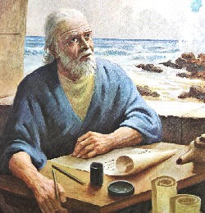
1. Jesus reveals the future and promises to bless all who read and obey the prophecy (1:1-3).
Why read Revelation?
343

Slide 30
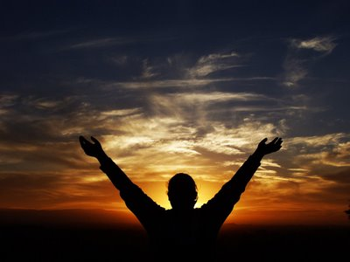
Characteristics
322
This is the only biblical book that promises a special blessing for reading it (1:3).
"God blesses the one who reads the words of this prophecy to the church, and he blesses all who listen to its message and obey what it says, for the time is near" (1:3 NLT)

Slide 31
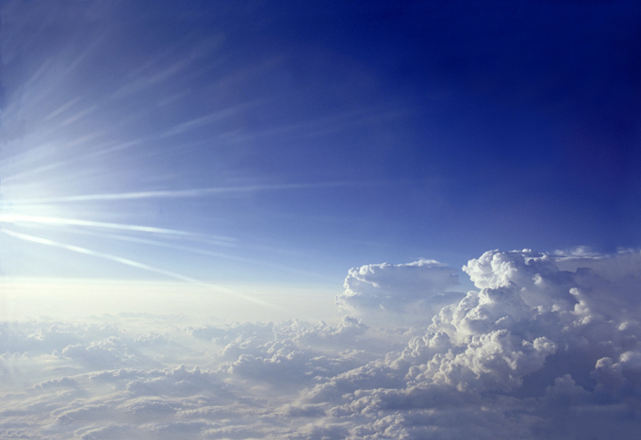
2. We should worship the Triune God because the Risen Ruler will soon return (1:4-8).
Why worship Jesus?

Slide 32
"Look! He comes with the clouds of heaven. And everyone will see him— even those who pierced him. And all the nations of the world will mourn for him. Yes! Amen!"
Rev. 1:7 NLT
cf. Zech. 12:10

Slide 33
"I am the Alpha and the Omega—the beginning and the end," says the Lord God. "I am the one who is, who always was, and who is still to come—the Almighty One" (1:8 NLT).
iii

Slide 34
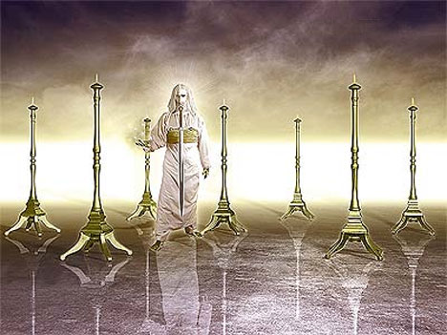
3. Seeing Christ glorified shows He can solve your problems (1:9-20).
Why see Jesus clearly?
343

Slide 35
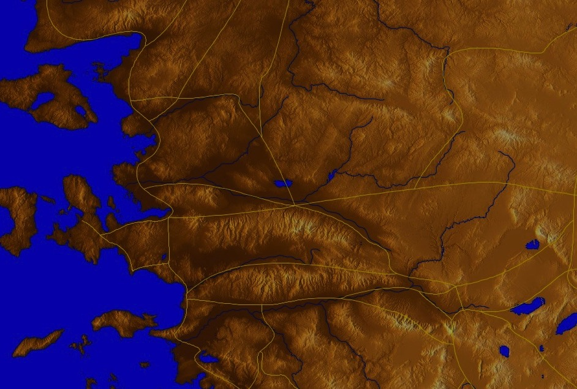
The 7 Churches (Rev. 2–3)
345
"It was the Lord’s Day, and I was worshiping in the Spirit. Suddenly, I heard behind me a loud voice like a trumpet blast. ¹¹It said, “Write in a book everything you see, and send it to the seven churches in the cities of Ephesus, Smyrna, Pergamum, Thyatira, Sardis, Philadelphia, and Laodicea" (Rev. 1:10-11 NLT).
Adramyttium
Aezani
Pergamum
Thyatira
Cyme
Erythrae
Sardis
Smyrna
Eumenia
Philadelphia
Lebedus
Colophon
Ephesus
Nysa
Laodicea
Hierapolis
Trailes
Heraclea
Aphrodisias
Colossae
Alabanda
Patmos
Miletus
Notes:
Jesus designed a brilliant strategy by having his revelation sent to capital of the province, Ephesus. It included an individual letter to Ephesus, as well as letters to 6 other key churches. The Ephesians copied the entire book of Revelation, though, and sent the original to the next city, Smyrna. Smyrna then made their own copy and sent the original to Pergamum, which lay on the main road to the north. This city then sent the prophecy to Thyatira, which sent it to Sardis, then Philadelphia, and finally to Laodicea.

Slide 36
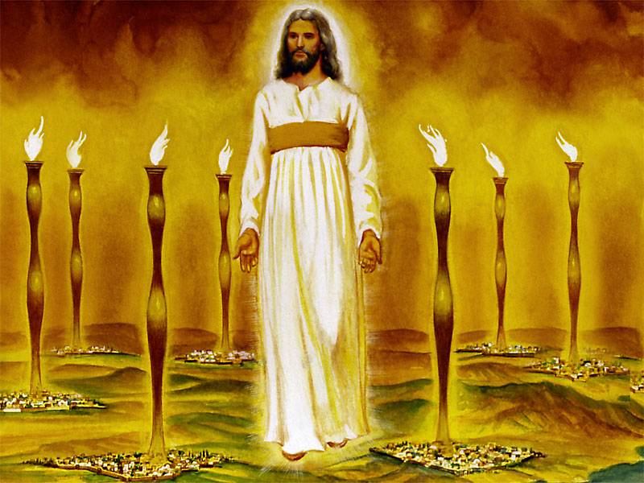
John's vision of the glorified Christ proves He can handle the Church's internal and external problems (1:12-16)
343

Slide 37
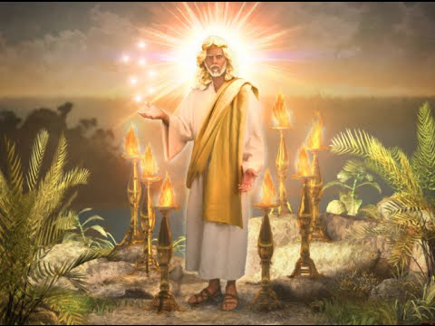
Judge-King: "robe reaching down to his feet and with a golden sash around his chest" (1:13)
Omniscience & Righteous Judgment: "eyes were like blazing fire" (1:14b; cf. Rev. 19:12; Heb. 4:12)
344
Eternality: "head and hair were white like wool" (1:14a; cf. "Ancient of Days" Dan 7:9, 13, 22)
Judgment: "feet were like bronze glowing in a furnace" (1:15a; cf. Rev. 19:12; Heb. 4:12)
—Warren Wiersbe, The Bible Exposition Commentary
Notes:
"Christ’s garments are those of a Judge-King, One with honor and authority. The white hair symbolizes His eternality, “the Ancient of Days” (Dan. 7:9, 13, 22). His eyes see all (Rev. 19:12; Heb. 4:12), enabling Him to judge righteously. His feet of burning brass also suggest judgment, since the brazen altar was the place where the fire consumed the sin offering. The Lord had come to judge the churches, and He would also judge the evil world system" (Wiersbe).

Slide 38
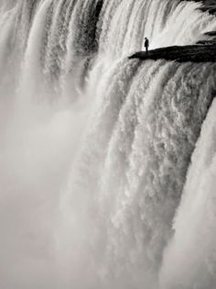
"…voice of many waters" (1:15b)
Christ gathers together all the "streams of revelation" and is the Father's "last Word" to man (Heb. 1:1–3)
He speaks with power and authority and must be heard" (Wiersbe).
Notes:
"The "sound of many waters" (Rev. 1:15) makes me think of Niagara Falls! Perhaps two ideas are suggested here: (1) Christ gathers together all the "streams of revelation" and is the Father's "last Word" to man (Heb. 1:1–3); (2) He speaks with power and authority and must be heard." (Wiersbe).

Slide 39
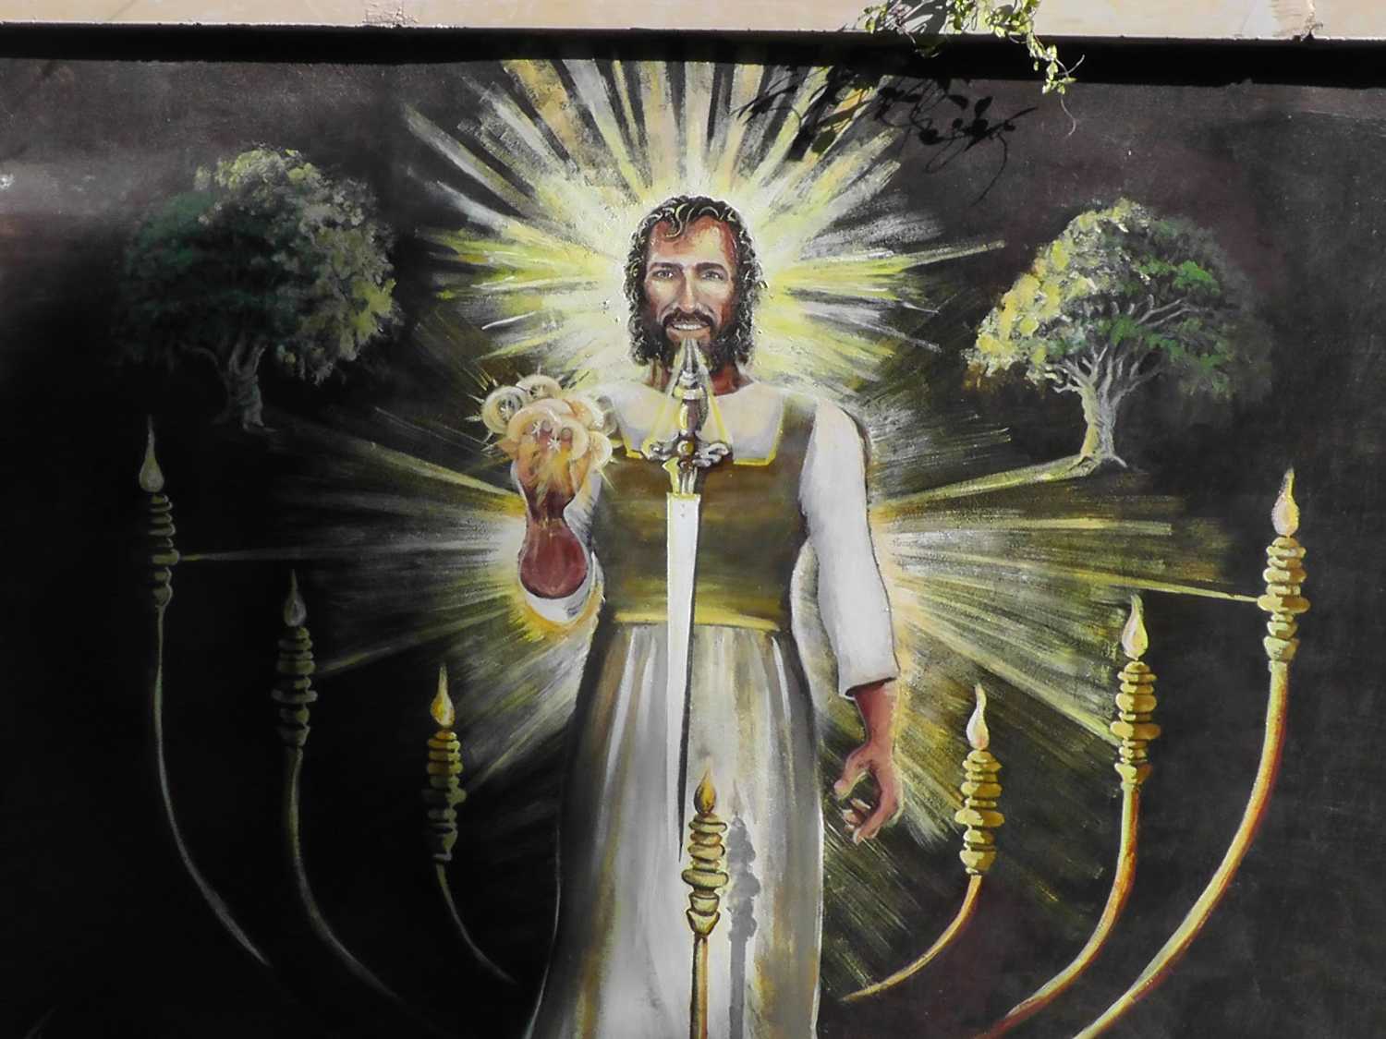
"…sword from his mouth" (1:16)
"…the living Word of God (Heb 4:12; Eph 6:17). He fights His enemies by using His Word (Rev 2:16; 19:19–21)" (Wiersbe).
Notes:
"The sword from His mouth certainly represents the living Word of God (Heb. 4:12; Eph. 6:17). He fights His enemies by using His Word (Rev. 2:16; 19:19–21)" (Wiersbe).

Slide 40
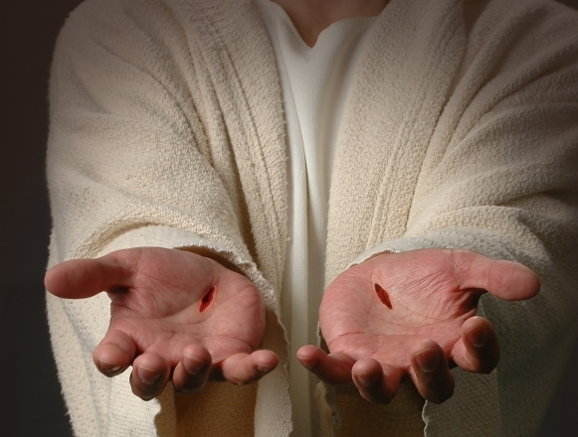
"When I saw him, I fell at his feet as if I were dead. But he laid his right hand on me and said, 'Don't be afraid! I am the First and the Last. ¹⁸I am the living one. I died, but look—I am alive forever and ever! And I hold the keys of death and the grave'" (Rev 1:17-18 NLT)
343

Slide 41
338
Follow Revelation's inspired outline
Revelation 1:19 "Therefore write the things which you have seen, and the things which are, and the things which will take place after these things" (NAU).
have seen
are
will take place

Slide 42
Revelation
Sovereignty of Christ in Future Victory
Sovereignty in His Person |  |  | Sovereignty over Churches | Sovereignty in End-Time Events
Chapter 1 |  |  | Chapters 2–3 | Chapters 4–22
"What you have seen" (1:19a) |  |  | "What is now" (1:19b) | "What will take place later" (1:19c)
Past |  |  | Present | Future
Christ Unveiled |  |  | Churches Unveiled | Consummation Unveiled
God on Earth |  |  | God's Ambassadors on Earth | Hell on Earth to Heaven on Earth
The Judge |  |  | The Assignments | The Judgments & Rewards
Subject 1:1-3 | Worship of Trinity 1:4-8 | Glorified Christ 1:9-20 | Seven Churches of Asia: Ephesus Smyrna Pergamum Thyatira Sardis Philadelphia Laodicea | Tribulation 4:1–19:10 | Second Coming 19:11-21 | Millennium 20 | Eternal State 21:1–22:5 | Closing: Imminency 22:6-21
AD 95
318, 324 M

Slide 43
We have victory when we see that Jesus rules over…
DEATH
(1)
CHURCHES
(2–3)
Outline of Revelation
Notes:
Churches (2-3): Christ is the boss over the seven Asian churches and every local church.

Slide 44
Revelation 2

Slide 45
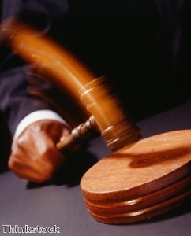
Christ has authority over all churches
344

Slide 46
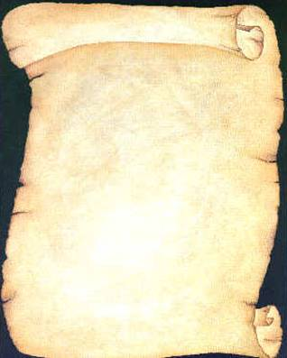
So Jesus wrote 7 churches (Rev 2–3)
Ephesus
Smyrna
Pergamum
Thyatira
Sardis
Philadelphia
Laodicea

Slide 47
Revelation
Sovereignty of Christ in Future Victory
Sovereignty in His Person |  |  | Sovereignty over Churches | Sovereignty in End-Time Events
Chapter 1 |  |  | Chapters 2–3 | Chapters 4–22
"What you have seen" (1:19a) |  |  | "What is now" (1:19b) | "What will take place later" (1:19c)
Past |  |  | Present | Future
Christ Unveiled |  |  | Churches Unveiled | Consummation Unveiled
God on Earth |  |  | God's Ambassadors on Earth | Hell on Earth to Heaven on Earth
The Judge |  |  | The Assignments | The Judgments & Rewards
Subject 1:1-3 | Worship of Trinity 1:4-8 | Glorified Christ 1:9-20 | Seven Churches of Asia: Ephesus Smyrna Pergamum Thyatira Sardis Philadelphia Laodicea | Tribulation 4:1–19:10 | Second Coming 19:11-21 | Millennium 20 | Eternal State 21:1–22:5 | Closing: Imminency 22:6-21
AD 95
318, 324 M

Slide 48
The 7 Churches (Rev. 2–3)
Promise
348
Pergamum
Warning
Thyatira
Exhortation
Rebuke
Commendation
Smyrna
Sardis
N/A
Christ
N/A
N/A
N/A
Ephesus
Philadelphia
N/A
Laodicea
Notes:
Though some exceptions exist (noted with “N/A” above), the basic pattern of the seven letters is a sevenfold outline:
Church name
Christ Described in a Unique Way for that Church
Commendation of Good Deeds among the Believers
Rebuke of Sin within the Church
Exhortation or Encouragement to Repent
Warning if the Exhortation is Disobeyed
Promise for Faithfulness
Notice also that each letter not only begins with a reference to Christ but ends with an appeal from the Spirit.

Slide 49
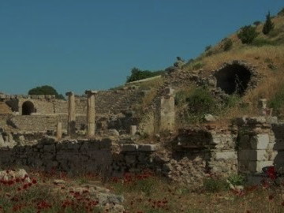
Ephesus Busy But Backslidden Revelation 2:1-7

Slide 50
Revelation 2:4 (NIV)
Remember when you loved at first?
Yet I hold this against you:
You have forsaken your first love.

Slide 51
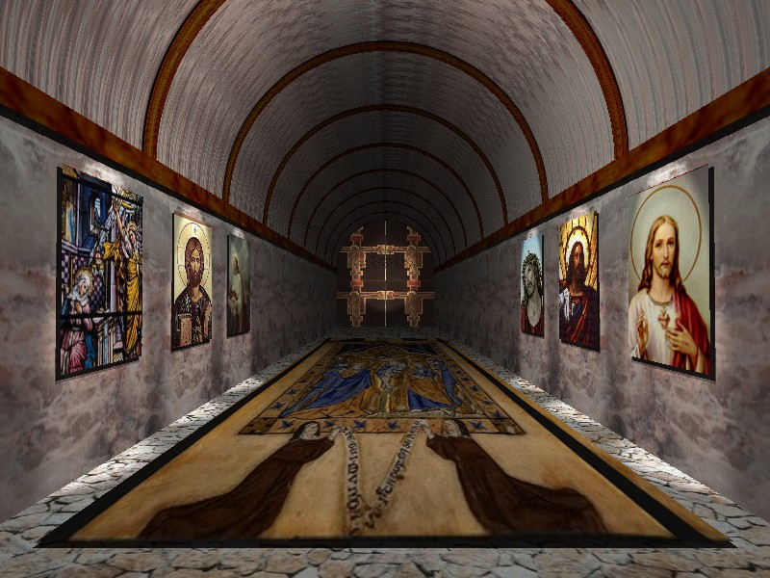
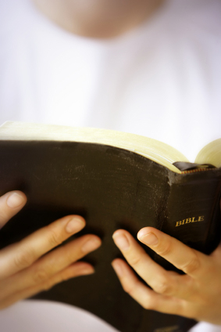
Revelation 2:4 (NIV)
Ephesus: Busy Yet Backslidden
Yet I hold this against you:
You have forsaken your first love.

Slide 52
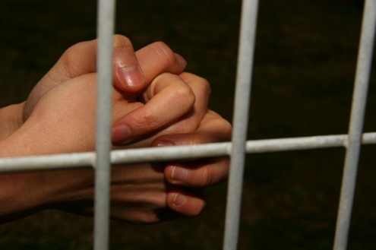
Suffering Yet Steadfast
The Church of Smyrna (Rev. 2:8-11)
Rick Griffith • Crossroads International Church • biblestudydownloads.com

Slide 53
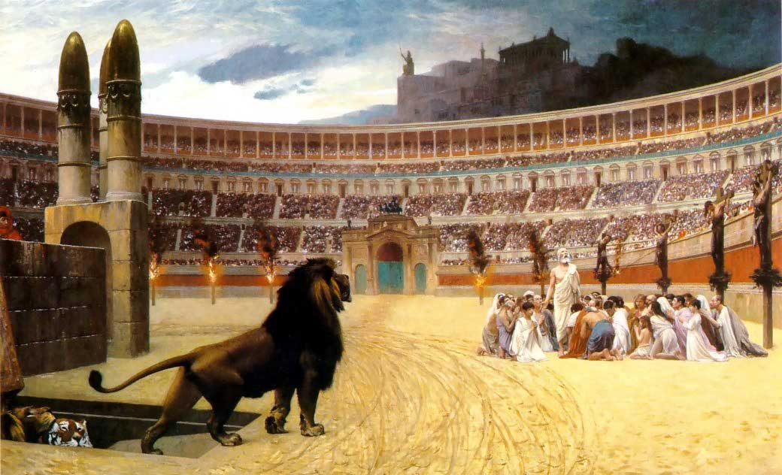
“Be faithful until death” (2:10c)

Slide 54
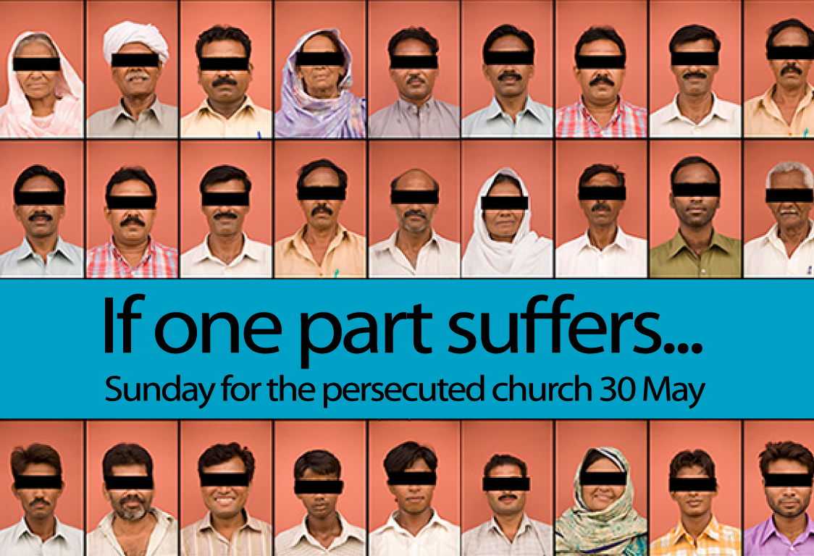
Our Response
If one part suffers…
Notes:
We have committed S$3000 to help 6 families who lost their bread winners for three months.

Slide 55
Dear Pergamum,
Compromising Yet Continuing
Revelation 2:12-17

Slide 56
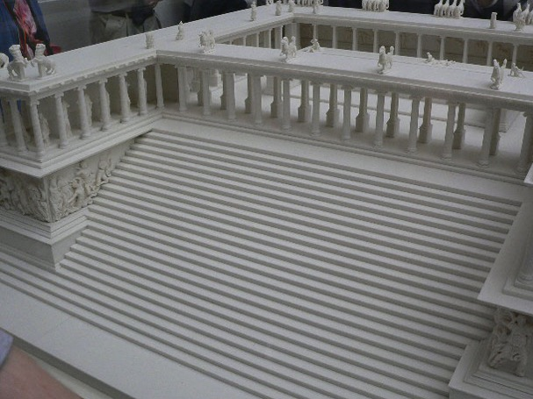
Altar of Zeus
353
"I know where you live—where Satan has his throne" (2:13)
Notes:
It has long been assumed that the temple was dedicated to Zeus. The altar is mentioned in the Book of Revelation, 2:11-12: "To the angel of the church in Pergamum, write this: . . . 'I know that you live where Satan's throne is . . . . '" This is a scale model of the altar.

Slide 57
Thyatira: Involved Yet Immoral
Revelation 2:18-29

Slide 58
Porn-Again Christian

Slide 59
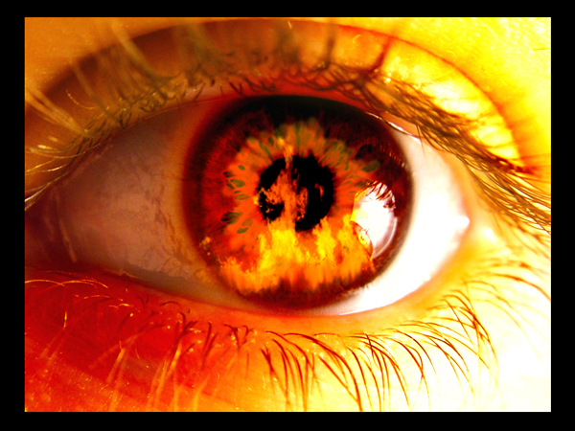
How does Jesus respond to immorality among believers?

Slide 60
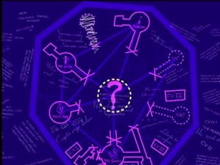
Service is no substitute for spotlessness
Main Idea for Thyatira:
Notes:
Activities can't replace adoration.
Good works can't replace godliness.
Perseverance can't replace purity.

Slide 61
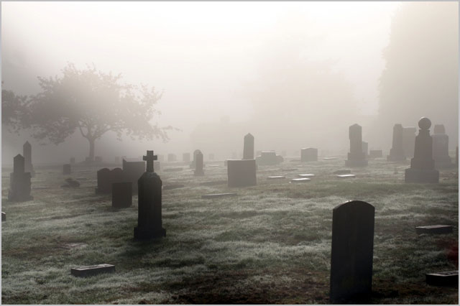
Distinguished Yet Dead
The Church of Sardis (Rev. 3:1-6)

Slide 62
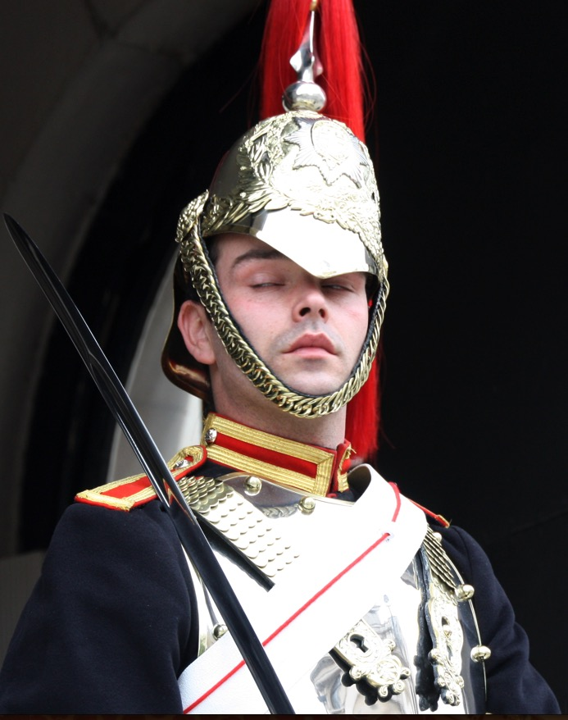
Sardis
358
Wake up! Strengthen what little remains, for even what is left is almost dead… If you don't wake up, I will come to you suddenly, as unexpected as a thief (3:2-3 NLT).

Slide 63
Will you wake up?
How can you be more spiritually awake in this coming year?

Slide 64
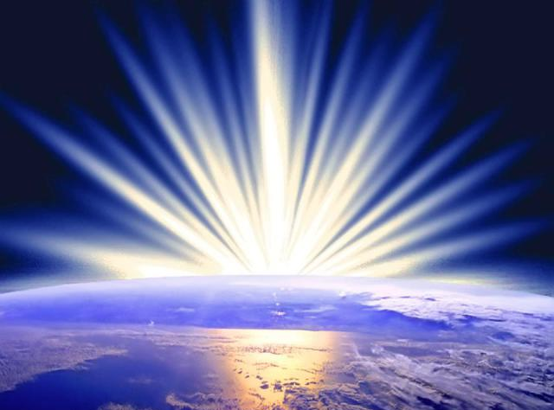
Mistreated Yet Missions-Focused
The Church of Philadelphia (Rev. 3:7-13)

Slide 65
What does Jesus want for us? Doesn't he want us to reach out?
How does Jesus encourage us to reach out?

Slide 66
Main Idea for Philadelphia
Jesus gives us both opportunities and rewards for witness

Slide 67
"Pre-Trib" Rapture
209 362
Rapture
Second Coming
1. "I will keep you from (ek) the hour of testing that will come upon the whole world, to test those who dwell upon the earth"
(Rev. 3:10)
"from, out of, away from"
ek
Tribulation
Millennium
dia
Church Age
"through"
Eternal Kingdom
7 years
1000 years
eis
"into"
Judgment
Notes:
"Frequently, but not always, ek means from within, while apo means from in a more general way (e.g., from the outside of, from the vicinity of)" (Eugene Van Ness Goetchius, The Language of the New Testament [New York: Charles Schribner's Sons, 1965], 151).

Slide 68
Luxurious Yet Lukewarm
The Church of Laodicea (Rev. 3:14-22)
Dr. Rick Griffith • Singapore Bible College • biblestudydownloads.com

Slide 69
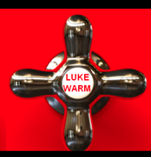
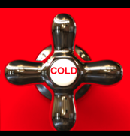
On fire for Christ!
"I wish that you were cold or hot" (3:15b). Really? Why?
HOT
LUKE WARM
COLD
Pretender
Reject Christ

Slide 70
How can you cure spiritual apathy?

Slide 71
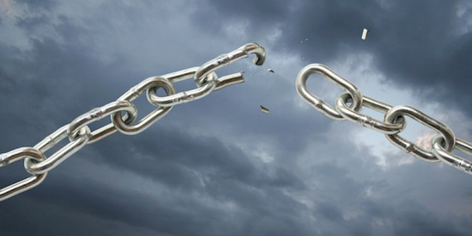
Replace self-reliance with Christ-reliance
Main Idea for Laodicea

Slide 72
We have victory when we see that Jesus rules over…
DEATH
(1)
CHURCHES
(2–3)
OUR FUTURE
(4–22)
Outline of Revelation
Notes:
Our Future (4-22): Christ is both Judge and Saviour of the End Times and our Eternal State.

Slide 73
Revelation 4

Slide 74
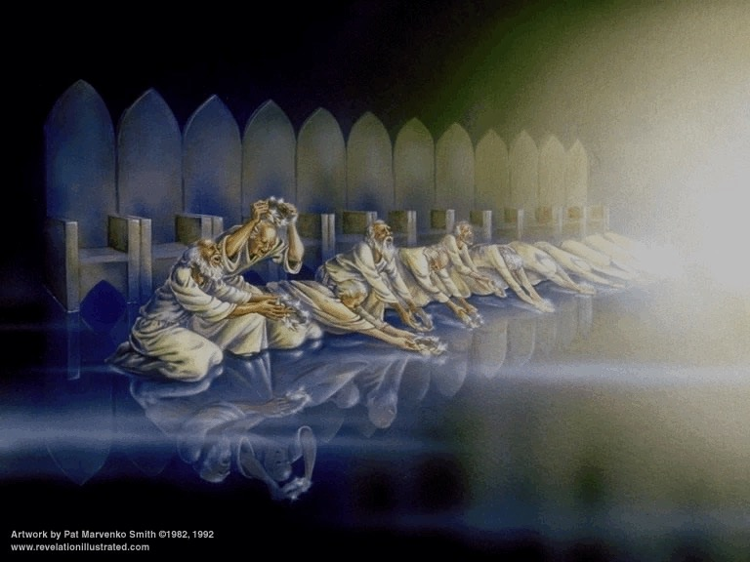
"Worthy are you, our Lord and God, to receive glory and honor and power, for you created all things, and by your will they existed and were created."

Slide 75
Revelation 5

Slide 76
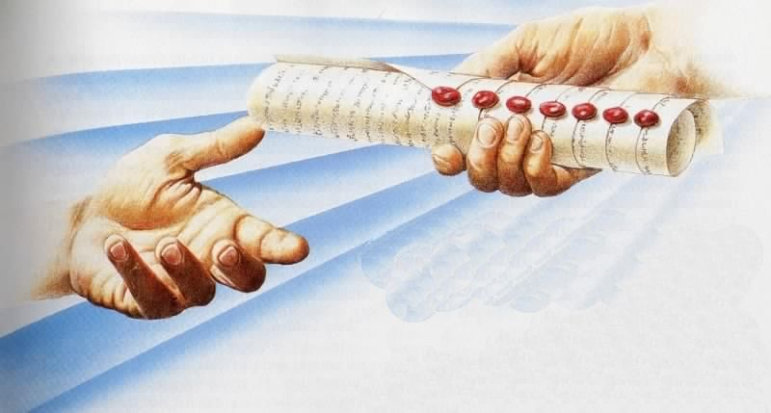
The Seal Judgments
369
The Scroll Sealed with Seven Seals…
is firmly in the right hand of the Father (5:1)!

Slide 77
Who is worthy to break the seal (5:1-4)?

Slide 78
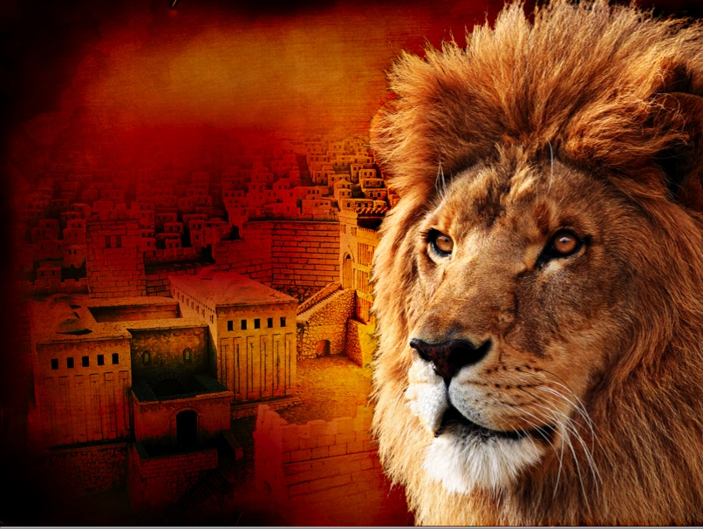
369
LION OF JUDAH
REVELATION 5:5

Slide 79
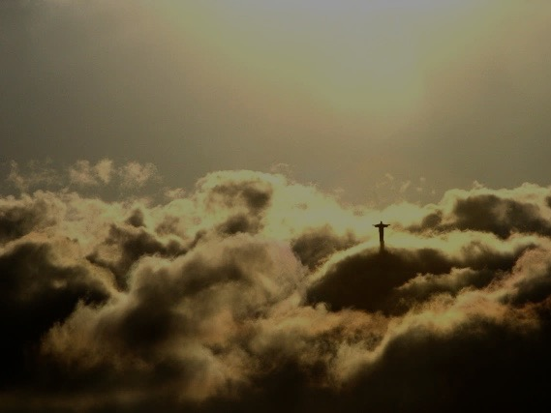
Main Idea of Revelation 5
Jesus is worthy to reveal the future and be worshiped because He is the Divine Messiah and redeemed us from the penalty of sin, making us a kingdom of priests.

Slide 80
Revelation 6

Slide 81
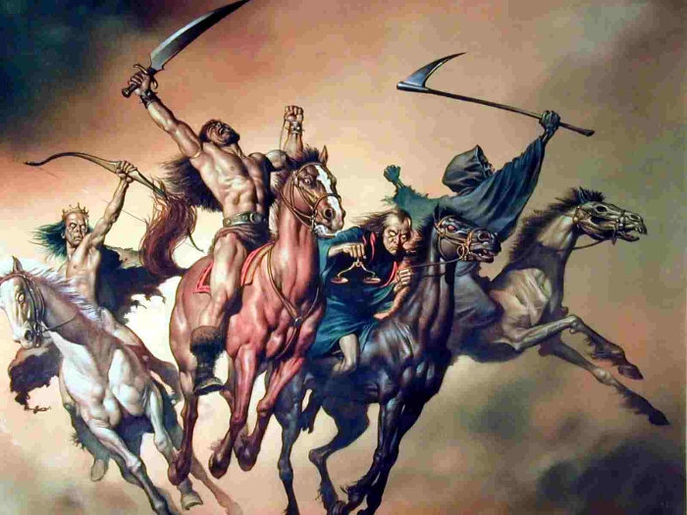
Tragedies of the Four Horses (6:1-8)
374
Conquest
War
Famine
Death

Slide 82
Chronology of Revelation
340
"What you have seen"
(1:19a)
Rev. 1
"What is now"
(1:19b)
Rev. 2–3
"What will take place later"
(1:19c)
Rev. 4–22
Vision of Christ
Church Age
Rapture 3:10
Tribulation
4:1 – 19:10
Second Coming
Millennium
First Half
Second Half
Eternal State
Great White Throne Judgment
Copyright 1989 Rick Griffith
Adapted from a chart by J. D. Pentecost
Notes:
The 3 main divisions of Revelation are summarized in 1:19
The 3 main cycles of judgment are squared in blue
The 4 parenthetical sections appear in parentheses within the scrolls. They do not advance the chronology but add important information that is not associated with a particular judgment.

Slide 83
Revelation 7

Slide 84
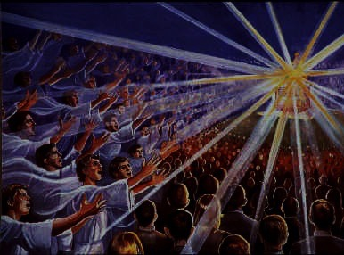
144,000 sealed (7:1-8)
377
And I heard how many were marked with the seal of God— 144,000 were sealed from all the tribes of Israel:
⁵from Judah 12,000
from Reuben 12,000
from Gad 12,000
⁶from Asher 12,000
from Naphtali 12,000
from Manasseh 12,000
⁷from Simeon 12,000
from Levi 12,000
from Issachar 12,000
⁸from Zebulun 12,000
from Joseph 12,000
from Benjamin 12,000
Notes:
"In Scripture, a seal indicates ownership and protection. Today, God's people are sealed by the Holy Spirit (Eph. 1:13–14). This is God's guarantee that we are saved and safe, and that He will one day take us to heaven. The 144,000 Jews will receive the Father's name as their seal (Rev. 14:1), in contrast to the "mark of the beast" that Antichrist will give those who follow him (Rev. 13:17; 14:11; 16:2; 19:20)" (Wiersbe).

Slide 85
The Multi-Racial People
379
"From every tribe, nation, language and people" (7:9)

Slide 86
Revelation 8

Slide 87
Seven Trumpet Judgments (8:6–11:19)
381
"When the Lamb broke the seventh seal on the scroll, there was silence throughout heaven for about half an hour. ²I saw the seven angels who stand before God, and they were given seven trumpets" (Rev. 8:1-2 NLT).
Notes:
"During this silence, the seven angels were given trumpets, significant to John, because he was a Jew and understood the place of trumpets in Israel's national life. According to Numbers 10, trumpets had three important uses: they called the people together (Num. 10:1–8); they announced war (Num. 10:9); and they announced special times (Num. 10:10). The trumpet sounded at Mount Sinai when the Law was given (Ex. 19:16–19), and trumpets were blown when the king was anointed and enthroned (1 Kings 1:34, 39). Of course, everyone familiar with the Old Testament would remember the trumpets at the conquest of Jericho (Josh. 6:13–16)" (Wiersbe).

Slide 88
Revelation 9

Slide 89
200 million soldiers!
Revelation 9:13-16 (NIV)
"The sixth angel sounded his trumpet, and I heard a voice coming from the horns of the golden altar that is before God. ¹⁴It said to the sixth angel who had the trumpet, 'Release the four angels who are bound at the great river Euphrates.' ¹⁵And the four angels who had been kept ready for this very hour and day and month and year were released to kill a third of mankind. ¹⁶The number of the mounted troops was two hundred million. I heard their number."
339
Notes:
89

Slide 90
Revelation 10

Slide 91
The Angel with the Little Scroll (10:1)
382
Notes:
"The fact that the angel's face is "as the sun" corresponds to the description of Jesus Christ in Revelation 1:16; his feet correspond to the Lord's description in Revelation 1:15. His voice like a lion suggests Revelation 5:5. This being could well be our Lord Jesus Christ, appearing to John as a kingly angel. Jesus often appeared in the Old Testament as "the Angel of the Lord" (Ex. 3:2; Jud. 2:4; 6:11–12, 21–22; 2 Sam. 24:16). This was a temporary manifestation for a special purpose, not a permanent incarnation.
Two other characteristics would suggest identifying the angel as Jesus Christ: the book in his hand and the awesome posture that he assumed. The little book contains the rest of the prophetic message that John will deliver. Since our Lord was the only One worthy to take the scroll and break the seals (Rev. 5:5ff), it might well be concluded that He is the only One worthy to give His servant the rest of the message.
The angel's posture is that of a conqueror taking possession of his territory. He is claiming the whole world (see Josh. 1:1–3). Of course, only the victorious Savior could make such a claim. The Antichrist will soon complete his conquest and force the whole world to submit to his control. But before that happens, the Savior will claim the world for Himself, the inheritance that His Father promised Him (Ps. 2:6–9). Satan roars like a lion to frighten his prey (1 Peter 5:8), but the Lion of Judah roars to announce victory (see Ps. 95:3–5; Isa. 40:12–17)" (Wiersbe).

Slide 92
Revelation 11

Slide 93
The Temple (11:1-2)
382
"Then I was given a measuring stick, and I was told, 'Go and measure the Temple of God and the altar, and count the number of worshipers. ²But do not measure the outer courtyard, for it has been turned over to the nations. They will trample the holy city for 42 months.'"

Slide 94
A Rebuilt Temple
382

Slide 95
Revelation 12

Slide 96
The Woman (12:1-6)
"Then I witnessed in heaven an event of great significance. I saw a woman clothed with the sun, with the moon beneath her feet, and a crown of twelve stars on her head. ²She was pregnant, and she cried out because of her labor pains and the agony of giving birth" (12:1-2 NLT).
384
Notes:
The woman is Israel, but what are the 12 stars on her head?
Genesis 37:9 compares the sons of Israel to 12 stars, 11 of which will bow down to Joseph.

Slide 97
The Dragon (12:3)
384
"Then I witnessed in heaven another significant event. I saw a large red dragon with seven heads and ten horns, with seven crowns on his heads" (12:3 NLT).
Notes:
Heads and horns both denote authority.

Slide 98
Chronology of the 70th "Week"
333
"And the woman fled into the wilderness, where God had prepared a place to care for her for 1260 days" (12:6).
Adapted from J. Dwight Pentecost, Dallas Theological Seminary, 1988
Middle of the Week
Sign of Son of Man Matt. 24:30
Christ's Return Complete
3½ YEARS
1290 DAYS
Dan. 12:11
30 DAYS
30 DAYS
1260 DAYS
45 DAYS
Rev. 11:3; 12:6
Dan. 12:12
3½ YEARS
3½ YEARS
Election of Beast Rev. 17:13
Covenant Made Dan. 9:27a
Covenant Broken Dan. 9:27b
2nd ADVENT
The Great Tribulation
The Tribulation

Slide 99
Slides on Revelation 13

Slide 100
Beasts of Rev. 13
387
Dragon = Satan
Land Beast = False Prophet
Sea Beast = Antichrist
Used with permission
Dr. Rick Griffith • Singapore Bible College • BibleStudyDownloads.org
Notes:
Slide 83 is adapted from Rev 1 intro slide
Slides 84-91 copied from Rev 20-22 presentation

Slide 101
The world will worship the beast
388

Slide 102
Slides on Revelation 14

Slide 103
The 144,000 Sing (14:1-5)
389

Slide 104
Slides on Revelation 15

Slide 105
Content of the Judgments
337
 | SEALS | TRUMPETS | BOWLS
1 | White: conqueror | Hail & fire: 1/3 vegetation | Sores
2 | Red: war | Fire: 1/3 sea creatures | Sea to blood
3 | Black: famine | Star: 1/3 fresh water | Fresh water to blood
4 | Pale: death | Dark: 1/3 sun, moon, stars | Sun burns men
 |  | (Trumpets 5-7 are woes)
5 | Martyrs reassured | Woe #1: locusts | Beast's kingdom dark
6 | Wrath: earthquake, signs | Woe #2: Euphrates prep | Euphrates dries up
 | (144,000 sealed) | (Trump #7 = mystery)
7 | 1/2 hour silence | Woe #3: victory imminent | Earthquake & hail
H O R S E S
W O E S
Adapted from Robert Gromacki, NT Survey and H. Wayne House, Chronological & Background Charts of the NT, 19

Slide 106
Slides on Revelation 16

Slide 107
Bowl Judgments (Rev. 16)
392
Used with permission

Slide 108
The Campaign of Armageddon (16:16 NLT)
394
Har (hill)
Megiddo
"And the demonic spirits gathered all the rulers and their armies to a place with the Hebrew name Armageddon (Har-magedon NAU)"
Notes:
"The name Armageddon comes from two Hebrew words, har Megiddo, the hill of Megiddo. The word Megiddo means “place of troops” or “place of slaughter.” It is also called the Plain of Esdraelon and the Valley of Jezreel. The area is about fourteen miles wide and twenty miles long, and forms what Napoleon called “the most natural battlefield of the whole earth.” Standing on Mount Carmel and overlooking that great plain, you can well understand why it would be used for gathering the armies of the nations.
It was on this plain that Barak defeated the armies of Canaan (Jud. 5:19). Gideon met the Midianites there (Jud. 7) and it was there that King Saul lost his life (1 Sam. 31). Titus and the Roman army used this natural corridor, as did the Crusaders in the Middle Ages. British General Allenby used it when he defeated the Turkish armies in 1917.
From a human viewpoint, it appears that the armies of the nations are gathering on their own; but John makes it clear that the military movement is according to God's plan. The satanic trinity, through demonic powers, will influence the nations and cause the rulers to assemble their armies. They will even work miracles that will impress the rulers and cause them to cooperate. But all this will merely fulfill the will of God and accomplish His purposes (see Rev. 17:17). The Gentile nations will look on Armageddon as a battle, but to God, it will be only a “supper” for the fowls of the air (Rev. 19:17–21)" (Wiersbe).

Slide 109
Slides on Revelation 17

Slide 110
The Prostitute & Beast
396
"So the angel took me in the Spirit into the wilderness. There I saw a woman sitting on a scarlet beast that had seven heads and ten horns, and blasphemies against God were written all over it" (17:3 NLT)

Slide 111
Slides on Revelation 18

Slide 112
But Babylon Will Be Ruined in One Hour by Fire
406
Pt. 6
So how can people part of the world system stand off and mourn the demise of the world system?
"In a single moment
all the wealth of the city is gone!” (18:17a NLT)
Used with permission
Notes:
She will be completely destroyed by the Antichrist and his ten-nation confederacy (17:16a) by fire (17:16b; 18:8) in only one hour (18:10, 17, 19).

Slide 113
Slides on Revelation 19

Slide 114
The Marriage & Wedding Supper of the Lamb
415
Notes:
114

Slide 115
"… a white horse, whose rider is called Faithful and True" (19:11)
417

Slide 116
Slides on Revelation 20

Slide 117
Binding of Satan (20:2-3a NLT)
421
"He seized the dragon… and bound him for 1000 years. He threw him into the Abyss, and locked and sealed it over him to keep him from deceiving the nations anymore until the 1000 years were ended…"
Used with permission
Notes:
Notice that Satan is not simply restricted from deceiving the nations but he is TOTALLY locked and sealed. The Amil theologians (see the next slide) say that this is a present reality. They claim he presently deceives individuals but not nations. My question is, "HOW MANY people within these nations are deceived by Satan?" Of course, the obvious answer is 100% (even though they say he can't deceive nations?!). It appears to me that ALL nations today are being deceived by this father of lies.

Slide 118
Revelation 20:1-6 Chronology
434
Satan bound 1000 years (1-3)
Saints come to life = first resurrection (4b, 5b)
Saints reign 1000 years (4c, 6b)
Second resurrection (5, 13)
Notes:
118

Slide 119
Millennial Jerusalem
434
"The law will go out from Zion,
the word of the LORD from Jerusalem"
—Isaiah 2:3
Notes:
119
BSD 420

Slide 120
Will everyone submit to Christ in the Millennium?
436

Slide 121
Satan is a master deceiver
436

Slide 122
Satan's Last Stand (Rev. 20:7-10 NLT)
436
"When the thousand years come to an end, Satan will be let out of his prison. ⁸He will go out to deceive the nations—called Gog and Magog—in every corner of the earth. He will gather them together for battle—a mighty army, as numberless as sand along the seashore. ⁹And I saw them as they went up on the broad plain of the earth and surrounded God's people and the beloved city. But fire from heaven came down on the attacking armies and consumed them.
¹⁰Then the devil, who had deceived them, was thrown into the fiery lake of burning sulfur, joining the beast and the false prophet. There they will be tormented day and night forever and ever."

Slide 123
"Then I saw a great white throne…" (20:11)
438

Slide 124
The Books (20:12)
Used with permission

Slide 125
"And anyone whose name was not found recorded in the Book of Life was thrown into the lake of fire" (20:15)
438

Slide 126
Slides on Revelation 21

Slide 127
The Consummation of All Things
175
Genesis 1–3
Revelation 20–22
"In the beginning God created the heavens and the earth" (1:1)
"Then I saw a new heaven and a new earth" (21:1)
Notes:
The first three chapters of Scripture have many parallels in the last three chapters.

Slide 128
The Cubed City
184

Slide 129
"…as a bride, beautifully dressed for her husband…"

Slide 130
The New Jerusalem over present Jerusalem
190

Slide 131
Slides on Revelation 22

Slide 132
Christ encourages us to live as if he can come any moment (22:7-17).
Blessing!
"Look, I am coming soon! Blessed are those who obey the words of prophecy written in this book" (NLT).

Slide 133
Main Idea of Revelation 22
Christ living with us encourages us to live for Christ

Slide 134
How can we be triumphant in Christ?
What do we need to grasp about Jesus for victory?

Slide 135
Jesus rules the world! So he can handle your puny problem.
Revelation’s Big Idea

Slide 136
We have victory when we see that Jesus rules over…
DEATH
(1)
CHURCHES
(2–3)
OUR FUTURE
(4–22)
Outline of Revelation
Notes:
Death (1): Christ is sovereign over our ultimate enemy that no one else has defeated.
Churches (2-3): Christ is the boss over the seven Asian churches and every local church.
Our Future (4-22): Christ is both Judge and Saviour of the End Times and our Eternal State.

Slide 137
For Pre-Christians: Have you submitted to Christ’s rule over you?
For Christians: What issue do you need to entrust to Jesus today?

Slide 138
Black

Slide 139
NT Preaching link at BibleStudyDownloads.org
Get this presentation for free!
Notes:
NT Survey (ns)

